Slide 1
Game Writing and Interactive Storytelling.
Session 03

Slide 2
OUTLINE
Basic Storytelling techniques
Story mechanism
Interactive Storytelling Techniques
Characters
Dialogue

Slide 3
Basic Storytelling techniques
Inciting Incident
Rising Action
Climax
Resolution
Pasing
basic story structure

Slide 4
Basic Storytelling techniques
Inciting Incident
major conflict of the story is introduced
predictable path, then bam!
grab the player’s interest

Slide 5
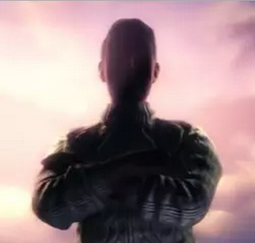
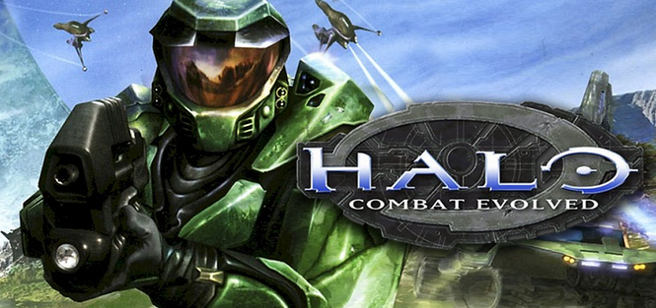
Basic Storytelling techniques
Inciting Incident
Ex:
<open video Bioshock eps1>
<open video Halo eps1>
Notes:
Bioshock: https://www.youtube.com/watch?v=4wYTklMok8E Halo: https://www.youtube.com/watch?v=TLsULaaovHY

Slide 6
Basic Storytelling techniques
Rising Action
begins to experience a series of conflicts that drive the story forward
majority of the gameplay occurs
form of puzzles to solve, enemies to fight, people to coerce, resources to gather, and many other ways, but what is key here is to keep the player moving through the story.

Slide 7
Basic Storytelling techniques
Pacing
Build tension and suspense within the player
character continually resolving small conflicts within the game, but not being allowed to solve the main conflict until the end
a good formula for achieving this is to put the cut scenes and slower action points after high action points, such as a dramatic confrontation, a huge revelation, or a boss fight

Slide 8
Basic Storytelling techniques
Climax
The climax is the point in thegame story where the major conflict of the story is resolved and all of the player’s questions get answered.
clues have led and the hero slays his archenemy, or rescues the princess, or disables the bomb and saves the world.
The players need to feel like they have won

Slide 9
Basic Storytelling techniques
Resolution
usually a brief portion of the narrative that gives the happy ending
shows the hero enjoying his success and is the reward for having won.
satisfy the players that have succeeded, and it helps them bring closure to the story

Slide 10
Story Mechanisms
Cut Scenes
Scripted Events
Artifacts
Nonplayer Characters
Internal Monologues
Triggered Events

Slide 11
Story Mechanisms
Cut Scenes
They have ranged from short camera changes, where the player sees something happening elsewhere in the game world, to cinematic masterpieces.
oftentimes view them as rewards for completing a level
way to slow down the action and create a rest point after a stressful boss battle

Slide 12
Story Mechanisms
Scripted Events
for example, when a character enters a scene and the camera moves to show a battleship full of enemies the player will soon be encountering, or it can be elaborate and show entire conversations or action sequences of NPCs

Slide 13
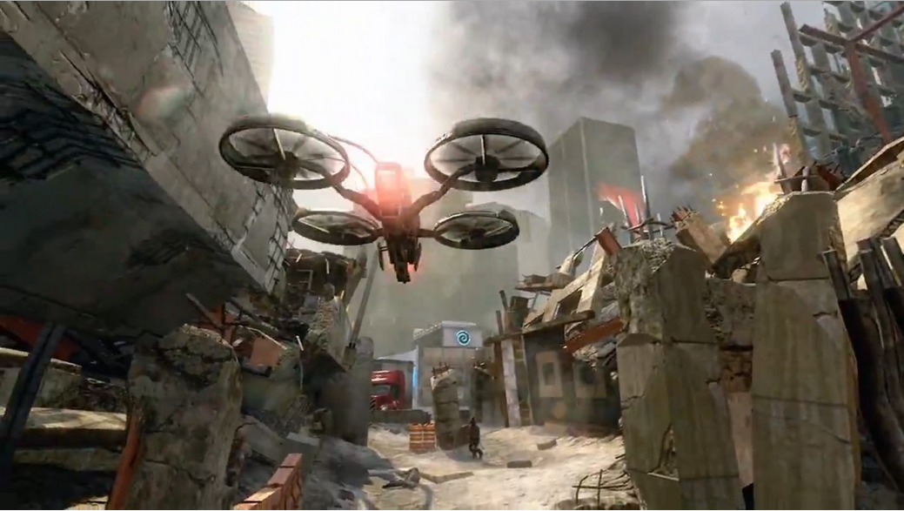
Call of Duty. Scripted events

Slide 14
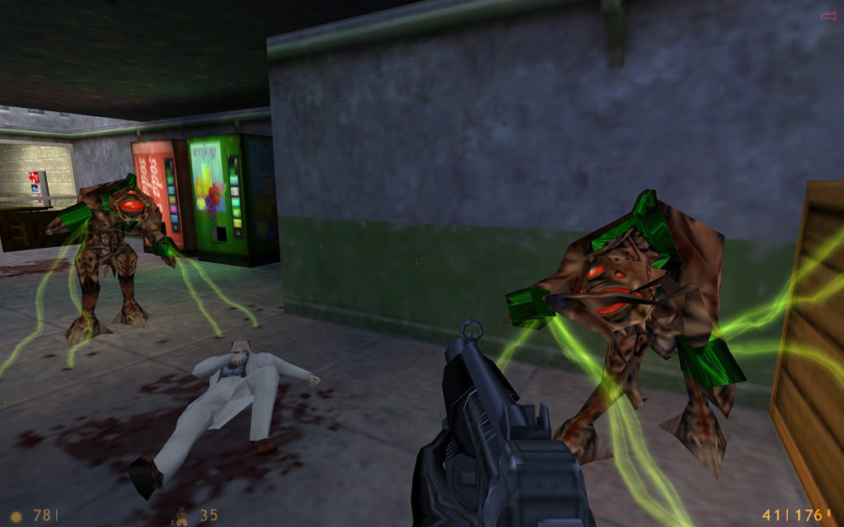
Half Life. Scripted events

Slide 15
Story Mechanisms
Artifacts
Artifacts are Items like posters, radio broadcasts, journals, letters, photos, CDs, laptops, and other items that contain information that advance the narrative
Leaving information on artifacts to be discovered by the player leaves the player feeling in control

Slide 16
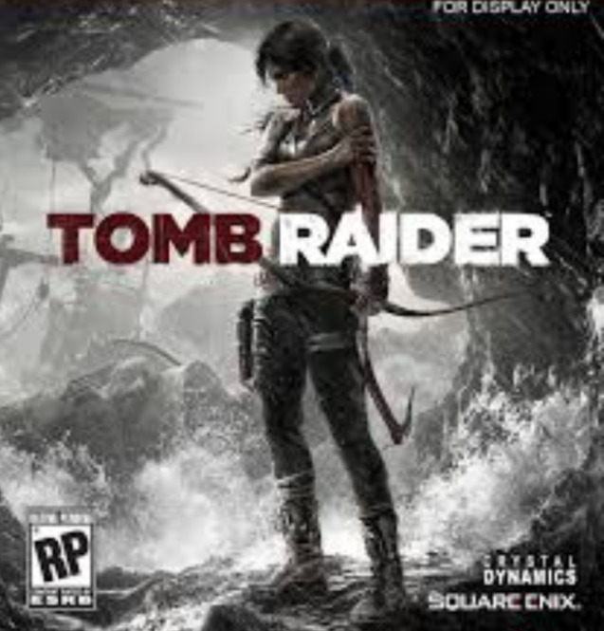
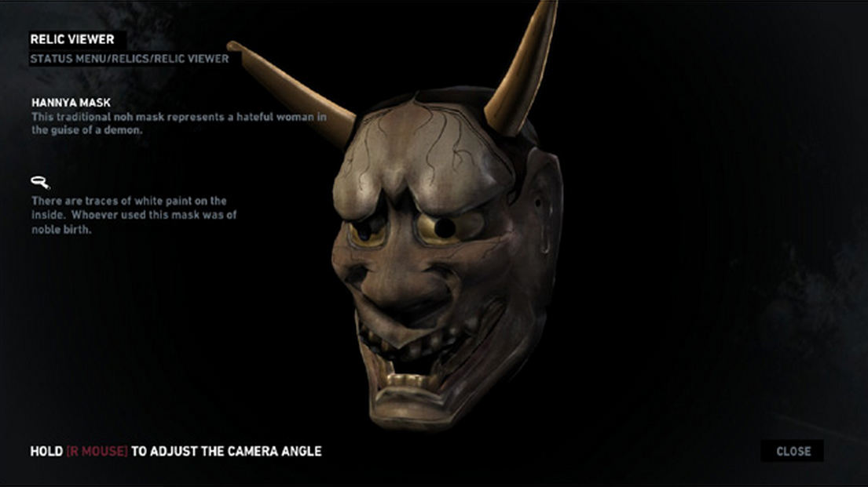

Slide 17
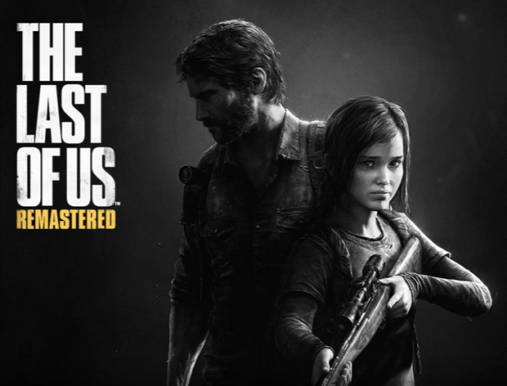

Slide 18
Story Mechanisms
Nonplayer Characters
Well-written nonplayer characters (NPCs) are essential for creating an immersive experience.
Ideally, each time a player has an encounter with an NPC, the interaction should be unique.
Therefore, when a character revisits an area, the NPC should have a new script to follow.
Ex: 12 characters in Far Cry 2 (next slide)

Slide 19

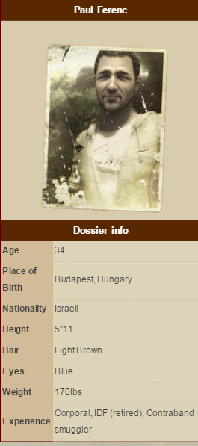
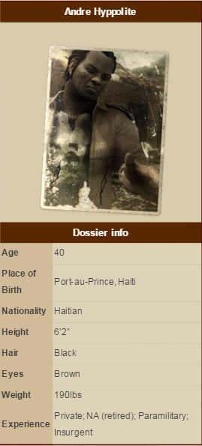
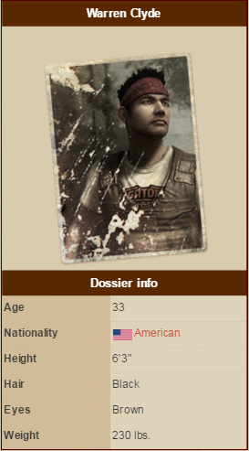

Slide 20
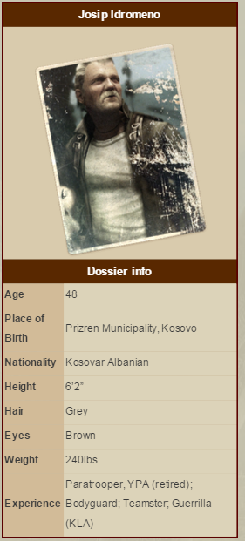
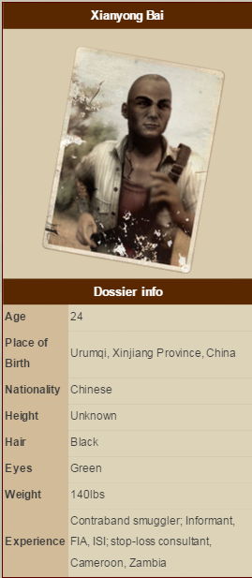
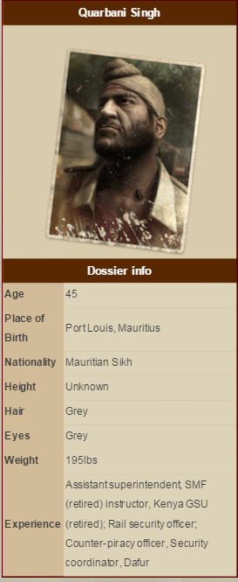

Slide 21
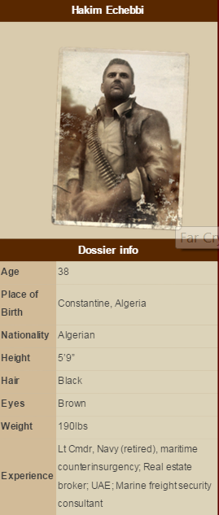
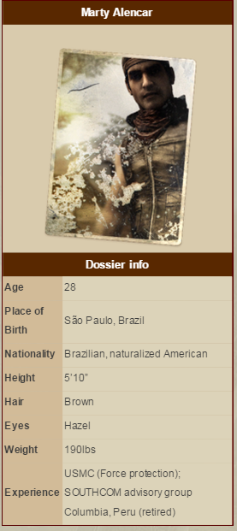
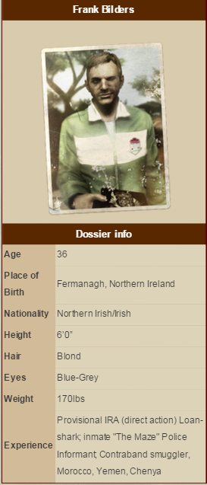

Slide 22
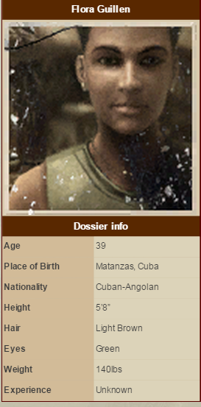
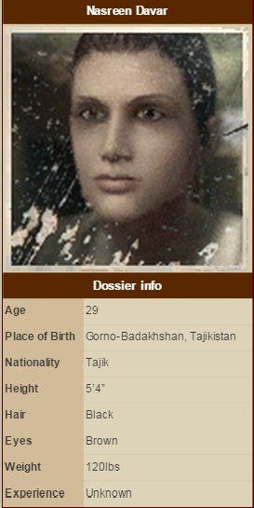
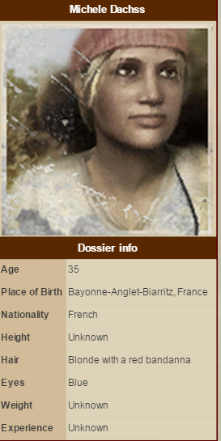

Slide 23
Story Mechanisms
Internal Monologues
self-talk that goes on inside a character’s head
If implemented correctly, the internal monologue can be a good method of conveying the story and essential information to the player
Example: The last of us (next slide)

Slide 25
Story Mechanisms
Triggered Events
A triggered event is one that is preplanned into the script and is prompted to occur once the player has activated a certain mechanism in the game
Example: (next slide)

Slide 26
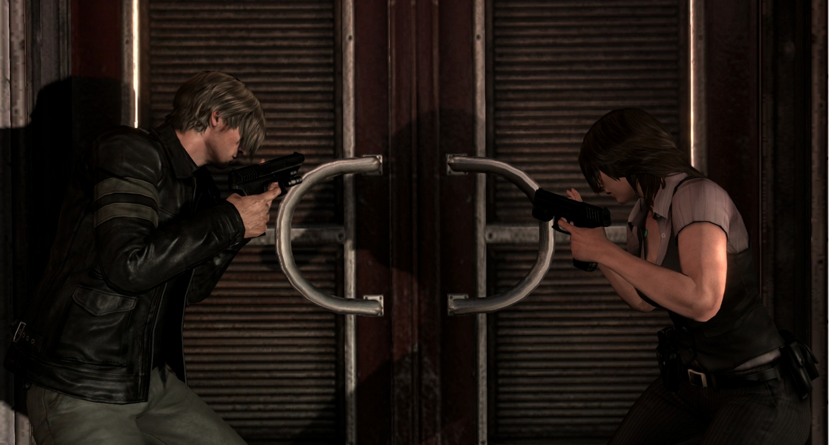

Slide 27
Interactive Storytelling Techniques
Player feels empowered to make choices
The choices he or she makes will affect things like:
where they live
who they marry
where they can shop
what they look like
how much money they have
and who their friends are, but not the major plot points
Allow the player to tinker with and interact with the game world as much as possible and show the player things that are happening outside of his own story

Slide 28
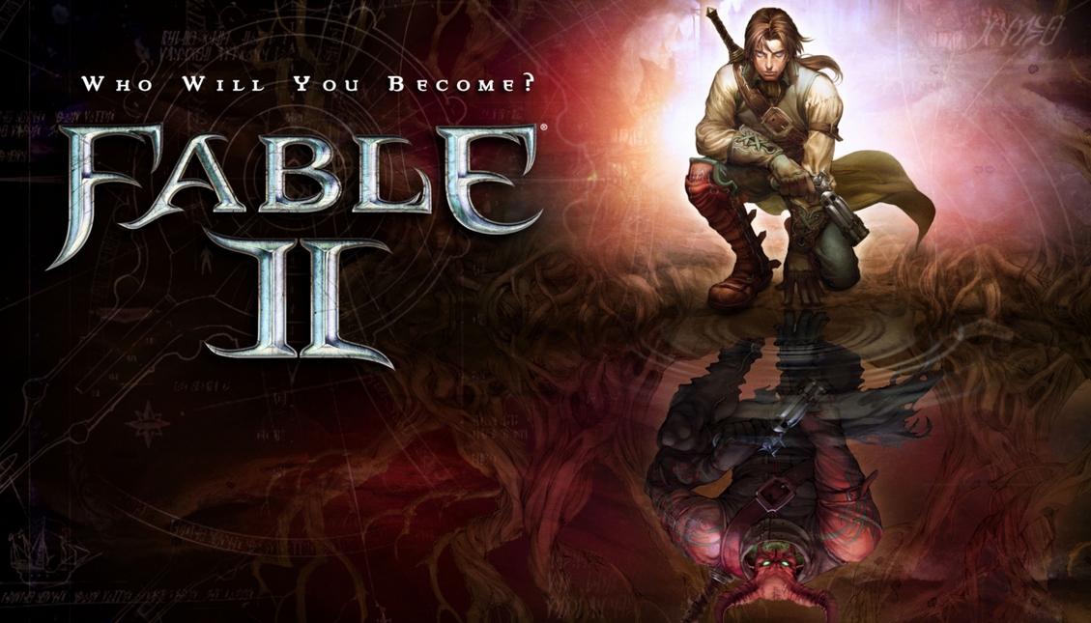
Example of: Interactive storytelling techniques

Slide 29
Interactive Storytelling Techniques
The Director
Another method for making a story interactive is to employ a director entity
The director evaluates the current state of the game and decides which set of obstacles to give to the player next
The director would evaluate in real time what obstacle would be most appropriate to present next to the character, based on what the player has previously accomplished
The more open a world is and the more options a player has for creating his or her own story, the less narrative that has to be written into the game.

Slide 30
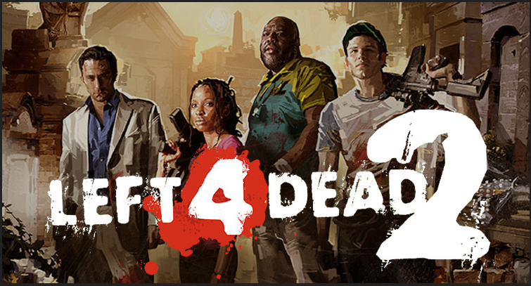
This was the method employed by Left 4 Dead to control pacing and enemy spawns based on the character’s current stress level.

Slide 31
Characters
Character writing is another responsibility of the game writer.
The goal of a well-written character is to evoke emotion within the player and to cause him to have strong feelings toward the characters.
In order for a game world to be convincing and immersive, the characters that exist within that world need to be compelling and three dimensional
The other part of this frame is the character’s attributes, such as his motivations, goals, aspirations, attitudes, character flaws, and temperament.

Slide 32
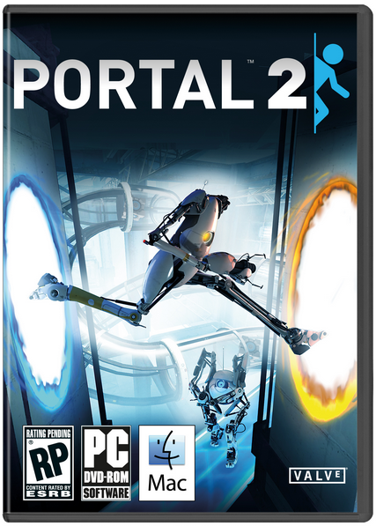

Slide 33
Dialogue
a video game is not a place for lengthy expositions, no matter how well written
the standard method of interacting with an NPC is to walk up to its avatar and click a button that initiates the opening of a dialogue box
less obvious trigger initiates the conversation, such as getting close to the NPC

